Slide 1
DER Technical Forum
02 February 2021
Join on your computer or mobile app
Click here to join the meeting
Or call in (audio only)
+44 20 3855 5885,,158353509# United Kingdom, London
Phone Conference ID: 158 353 509#

Slide 2
Welcome, Housekeeping and Introductions

Slide 3
Agenda
Time | Focus | Leader
14:00 | Welcome, Introductions and Acceptance of Agenda. | CM
14:02 | Acceptance of minutes of previous meeting (15 December 2020) | CM
14:05 | Update on Housekeeping etc Modification | CM/MK/SRC/CN
14:30 | New issues raised Short term paralleling clarity | MK
14:35 | Remaining Open Issues: 101 – load rejection simulations for Type C and D 106 – small rotating machines 107 DRUPS | MK
14:45 | Update on Storage Modification | CM/MK/SRC
14:50 | G100 – update | AH/MK
15:10 | TTR etc update (if any) | CM/MD
15:15 | EU standards etc | CM/MK
15:20 | AOB
15:25 | Finish and next meeting | CM

Slide 4
Update on minor technical modifications (previously referred to as housekeeping modifications)

Slide 5
Revised Timeline following 03/12/20 DCRP

Slide 6
Update on Minor Technical Modifications
Any comments / points to discuss from draft G98 and G99 documents

Slide 7
New Issues

Slide 8
New Issues
No | Issue | Assumed Status
108 | Significant differences are sometimes observed between the requirements of different DNOs in relation to standby generation protection, studies and commissioning. | It is proposed to add the following new text to G99. 15.7 Compliance demonstration for Infrequent Short-Term Parallel Power Generating Modules 15.7.1 Compliance of a Power Generating Module connected to provide infrequent short-term parallel operation should be demonstrated for the applicable requirements and design variations as detailed in Section 7.3. As a minimum this will include: Provision of a Standard Application Form Compliance with Section 8 (Earthing) Compliance with Section 9 (Network Connection Design and Operation) Compliance with Section 10 (Protection) Compliance with Section 14 (Installation, Operation and Control Interface) Compliance with Section 15 (Common Compliance and Commissioning Requirements) 15.7.2 It is recommended that the certification, connection and notification process for the applicable Power Generating Module type is followed, whilst taking into account the technical exclusions detailed in Annex A.4.3. Thus some rows in the compliance forms A2-1, A2-2, A2-3, B2 and C2 can be marked as exempt; for example in form B2, rows associated with Reactive Power capability and frequency performance can be noted “E” for exempt.

Slide 9
Other emerging issues:
Power swings from battery storage – is the following (reconnexion) text in G99 sufficient?
10.3.4 The frequency and voltage at the DNO’s side of the supply terminals at the Connection Point shall be within the frequency and voltage ranges of the Interface Protection as listed in paragraph 10.6.7 for at least 20 s before the Power Generating Module is allowed to automatically reconnect to the DNO’s Distribution Network. There is in general no maximum admissible ramp rate for Active Power output on connecting or reconnecting, although it is a requirement to state the assumed maximum ramp rate for the Power Generating Module as part of the application for connection. If a network specific issue requires a maximum admissible ramp rate of Active Power output on connection it will be specified by in the Connection Agreement.
Does the second sentence need breaking out as a more generic requirement?
Are there other P28 implications we should refer to?
The SAF specifically asks for ramp rates (see next slide)

Slide 10
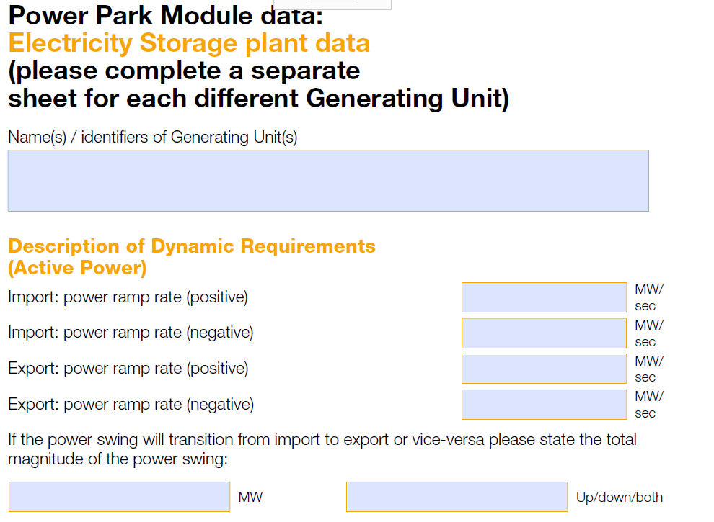
SAF Extract:

Slide 11
Previous Issues

Slide 12
Unresolved Previous Issue
No | Issue | Assumed Status
101 | The issue is the LFSM-O load rejection test, and the scenario given in Appendix C7.5. For a project I have setup a test network for a Type C solar PV site, rated at 15MW and connected at 33kV which has generated some queries. Specifically: It is not clear what the ultimate aim of the test is? ie is it just to show the speed at which the inverters can de-load in the case of an over-frequency condition (ie like the equivalent Type B LFSM-O simple ramp test), or is it to show the system can actually form an island - which doesn’t make sense as the inverters do not have grid forming capability. The value ‘X’ seems to be arbitrary, and the standard wording implies that we just adjust this value until we get the required 52Hz deviation and add the generator rating to this value? Is this above assumption correct or is the value X supposed to be the Design Minimum Operating Level (DMOL)? Whilst practically a solar PV plants minimum, operating level can be very low at say 5% or less, but the inverters would not be able to handle a load rejection of 95%, and most DNO connection agreements, don’t give specific values in the way Grid connection offers do. What is the guidance for selecting the rating of the dummy generator ‘G2’, I have found that setting the value to the same rating as the site, seems to provide the correct response.. but not sure if this is correct? I have also found that it is necessary to add a simple AVR model to the dummy ‘G2’ generator to help stabilise the voltage on the islanded system… I assume this is ok, as the standard only talks about excluding the governor? What is considered a ‘pass’ for this study ie what things are you looking to see? | Still under discussion following response from NGESO

Slide 13
Unresolved previous issues - 2
No | Issue | Assumed Status
106 | Some of the tests in A2, notably Loss of Mains and Harmonics, require operation at power outputs from 1.0pu down to 0.10pu. This is not possible for some rotating machines as it is below the level at which the machine is capable of operating. Therefore the tests in A2 cannot be completed. | The G98 and G99 Type A approach is based on G83, and to a lesser extent G59. These were originally written with inverters exclusively in mind, although drafting was completed for synchronous machines. Little explicit recognition was made of induction generators. It seems that there was very little experience of the application of G83 to rotating machines because of the absence of rotating machines of that size (3kW) from the market. G98 and G99 carried most of this drafting forward as far as possible, not least to be backward compatible. DNOs recognize this problem and note that small machines generally have a limit of stable operation – probably in the 30% to 60% of Registered Capacity. Below this they become uncontrollable/unstable. This is a feature of all rotating machines. It is also worth noting that G99 explicitly recognizes this for Type C rotating machines, and allows tests to be proposed by the Generator that do not take the module below its Minimum Stable Operating Level – this is an issue principally for FSM, which is why it is not specifically included for Type B. However there is nothing to stop this approach explicitly being applied to Type A and B modules. In the light of the practical issues this poses for manufacturers or owners in conducting such tests the DNOs propose to amend G98 and G99 to allow for an alternative test point above the minimum stable operating level, and suggested to be 5% of the difference between Registered Capacity and minimum stable level above the minimum stable level. DNOs will propose this change in the housekeeping and minor changes modification that is expected to be formally progressed early in 2021. In the meantime DNOs would expect manufacturers and DNOs to work to the proposal above.

Slide 14
Unresolved previous issues - 3
No | Issue | Assumed Status
107 | Is a diesel rotary uninterruptable power supply (DRUPS) to be treated as a generator running in long term parallel mode? | Our understanding is that in normal operation the synchronous machine has an significant moment of inertia (flywheel) and is motoring, and that on loss of mains it then generates into the load. The connexion with the DNO’s system is interrupted by a circuit breaker, and a fast start diesel then powers the synchronous machine so it then becomes an islanded generator supplying the installation. Clearly the earthing and other arrangements need to be designed for these modes of operation. It is probably appropriate to include a reference to this as a valid instance of uncontrollable storage.

Slide 15
Update on Storage and G100

Slide 16
Storage – DCRP/MP/20/06
The DCRP has asked for the consultation to be run for eight weeks, starting this week – so comments are due back on Friday 12 February.
There have been no significant changes to the drafting or the consultation since the report on progress to the DER Tech Forum on 03 November.

Slide 17
G100
Meetings were held with stakeholders on 06 January and on 01 February 2021.
Following a constructive meeting, on 06/01 a first draft of a revised document was produced.
The meeting on 01 February 2021 discussed the draft in detail and made a number of suggestions for improvements and clarifications
The next meeting will be in March where it is hoped to review a draft that might be close to being ready for consultation and a draft consultation paper.

Slide 18
Type Test Register etc Update

Slide 19
Wrap up:

Slide 20
Minutes of previous meeting and actions
Outstanding matters arising not on the agenda:
None?

Slide 21
AOB and next meeting
AOB
None
Next meeting
Around April?

Slide 22
© ENA 2020

